Slide 1

Portfolio Optimization in the Indian Market A Gram-Schmidt Orthogonalization Approach

Slide 2
Project Participants
Shruti Khapekar (A028) 86062400066
Atharva Pendem (A053) 86062400060
Sandesh Tayde (A070) 86062400020
Shubhi Yadav (A075) 86062400023
Akash Yadav (A076) 86062400029
Mentor
Dr. Debasmita Mukherjee

Slide 3
content
Introduction
Rationale
Literature Review
Aim & Objective
Data Description
Exploratory Data Analysis
Data Description
Methodology
Analysis
Results & Conclusion
Limitations & Future Scope
References

Slide 4
introduction
In modern finance, Risk Parity/Budgeting offers a balanced approach to portfolio allocation by focusing on each asset’s risk contribution, not just returns. Unlike traditional methods, this strategy prevents over-concentration, enhancing diversification during market volatility.
This study introduces a new method using Gram-Schmidt orthogonalization to implement Risk Parity/Budgeting, aiming to reduce concentration risk and improve portfolio resilience. Our findings provide insights for investors seeking optimized, risk-balanced strategies in complex markets.

Slide 5
rationale
This study addresses the need for adaptive risk management in the Indian financial market, where asset volatility and correlations fluctuate with economic changes. Traditional portfolios often concentrate risk in high-volatility assets, increasing exposure to market declines. By using risk parity to balance risk across assets and applying Gram-Schmidt orthogonalization to create uncorrelated risk sources, this research offers a strategy tailored to the unique dynamics of Indian assets. The combination of these methods aims to support investors and portfolio managers in building resilient portfolios that achieve balanced risk-adjusted returns, helping them navigate the complexities of emerging markets.

Slide 6
Literature Review
Title: A Method for Risk Parity/Budgeting Portfolio Based on Gram-Schmidt Orthogonalization
Authors: Kensuke Kamauchi, Mercer Investments (Japan) Ltd., Tokyo Daisuke Yokouchi, Hitotsubashi University, Tokyo
Abstract: This paper introduces a Risk Parity/Budgeting Portfolio approach using Gram-Schmidt Orthogonalization to improve asset-based and principal component risk portfolios. The new method offers more interpretable portfolio weights with similar performance and volatility to existing approaches, addressing limitations in current strategies.

Slide 7
OBJECTIVE
Evaluate the volatility and returns of Portfolio.
Compare the performance of risk parity and risk budgeting portfolios with the proposed Gram-Schmidt Orthogonalization method.
Determining the optimal order of orthogonalization which is crucial to ensure that the method effectively balances risk contributions and improves diversification.

Slide 8
data description
Sensex & Nifty 50: Daily returns from India's top stock indices (BSE & NSE).
Bond Exchange Rates: 10-year government bond yields reflecting market trends.
Gold Rates: Daily closing prices of gold in INR, a key economic hedge.
Currency Exchange Rates: Daily INR/USD rates, reflecting global market dynamics.
Data Sources:
Reserve Bank of India (RBI)
National Stock Exchange (NSE)
Bombay Stock Exchange (BSE)
Commodity Markets
Period: 2014-2023

Slide 9
Data Sample
Date | Sensex | Nifty 50 | Bond Rates | Gold Rates | Currency Rates
01-01-2023 | 59,549.90 | 17,662.15 | 7.343 | 1,962.20 | 81.74
02-01-2023 | 58,962.12 | 17,303.95 | 7.457 | 1,853.20 | 82.64
03-01-2023 | 58,991.52 | 17,359.75 | 7.315 | 2,004.10 | 82.16
04-01-2023 | 61,112.44 | 18,065.00 | 7.116 | 2,018.30 | 81.72
05-01-2023 | 62,622.24 | 18,534.40 | 6.989 | 1,982.10 | 82.68
06-01-2023 | 64,718.56 | 19,189.05 | 7.11 | 1,929.40 | 82.09
07-01-2023 | 66,527.67 | 19,753.80 | 7.172 | 2,009.20 | 82.24
08-01-2023 | 64,831.41 | 19,253.80 | 7.166 | 1,965.90 | 82.7
09-01-2023 | 65,828.41 | 19,638.30 | 7.21 | 1,885.40 | 83.03
10-01-2023 | 63,874.93 | 19,079.60 | 7.351 | 1,994.30 | 83.26
11-01-2023 | 66,988.44 | 20,133.15 | 7.279 | 2,038.10 | 83.36
12-01-2023 | 72,240.26 | 21,731.40 | 7.176 | 2,071.80 | 83.19

Slide 10


Exploratory Data Analysis
Volatility:
The volatility of each asset class is computed over the sample period. The volatility measures the degree to which the asset's returns deviate from the mean, and it is often computed using the standard deviation of returns.
Simple Return
Daily Volatility

Slide 11
Sensex and Nifty 50 have high volatility i.e., they have higher risk but the also have the chance of getting higher returns.
Gold prices vary moderately, which offers a mixture of stability as well as risk.
Most stable options are Government Bonds and Exchange Rates, with lower price changes.
Financial Variables | Volatility
Sensex | 0.04903939
Government Bond | 0.02562743
Nifty 50 | 0.04934217
Gold Rates | 0.03911159
Currency Rates | 0.01481852

Slide 12
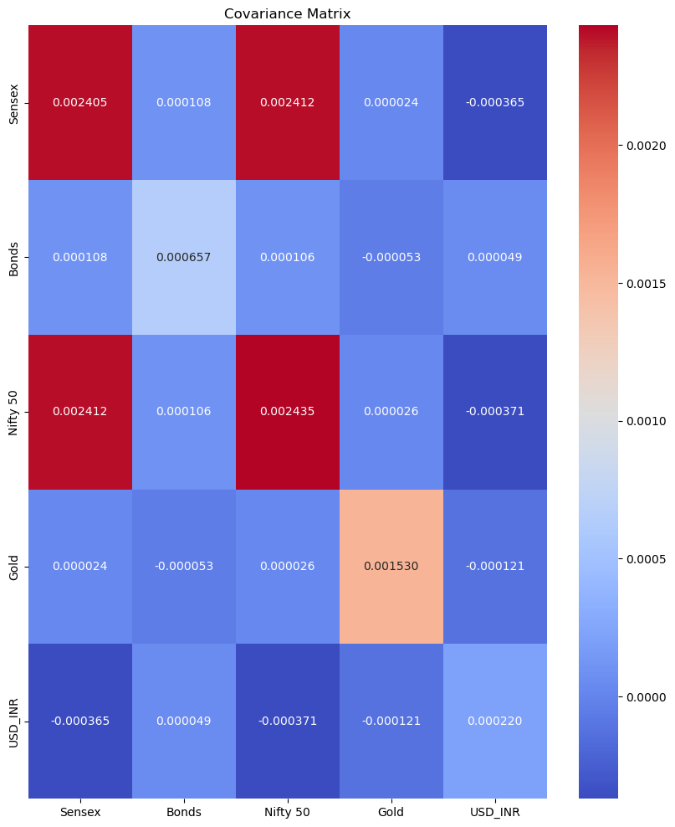
Covariance Analysis
Covariance analysis is used in finance to measure how to assets proceed together.
Positive covariance indicates that the two assets tend to fluctuate together. Negative Covariance indicates that if the price of one asset rises when the price of the other asset falls down.

Slide 13
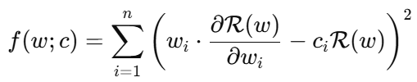
1. Risk Parity Portfolio (RPP)
The aim in RPP is to allocate equal risk contribution for each asset, which will assure that risk is not concentrated in just one or more than one asset.
Optimal Weight:
Variables | Sensex | Bonds | Nifty 50 | Gold | USD_INR
Values | 0.1522038 | 0.41265417 | 0.15133537 | 0.28380666 | 0.0
The weights are adjusted to achieve this equal risk contribution, with one asset excluded (weight of 0) because it’s not needed to balance the risk.
As, one asset has a weight of 0.0, meaning it doesn’t contribute to the portfolio. This can happen if the asset is either too low-risk to impact the total risk significantly or if adding it would disrupt the desired equal risk contribution.

Slide 14
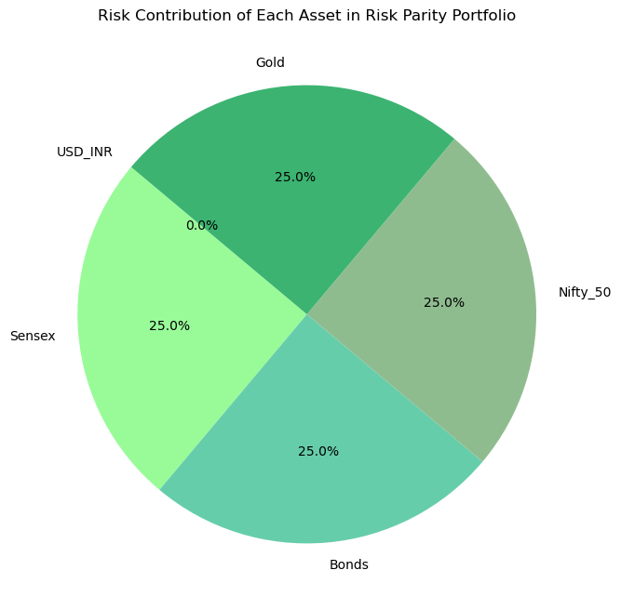
Risk Contributions:
Variables | Sensex | Bonds | Nifty 50 | Gold | USD_INR
Values | 0.25000996 | 0.2498667 | 0.25001706 | 0.25010628 | 0.0
Each asset contributes approximately 25% to the overall portfolio risk, which is exactly what the RPP approach aims to achieve.
The negative risk contribution for the last asset aligns with the zero weight it has no presence in the portfolio and henceforth no contribution to total risk.

Slide 15

2. Risk Budgeting Portfolio (RBP)
The aim of RBP is to assign, each asset a predefined risk budget unlike RPP, that has equal risk contributions. The process of optimization in RBP adjusts asset weights so that it match these specified risk budgets.
Optimal Weight:
Variables | Sensex | Bonds | Nifty 50 | Gold | USD_INR
Values | 0.18127401 | 0.39635772 | 0.18032156 | 0.24204671 | 0.0
The weights 0.181 for Sensex, 0.396 for Bonds, 0.1803 for Nifty 50, 0.2420 for Gold, 0.0 for Currency Exchange determined to achieved the risk of 0.25,0.15,0.25,0.1,0.25 respectively.
The zero weight for USD_INR indicates it’s excluded from the portfolio, as including it may not align with your target contributions.

Slide 16
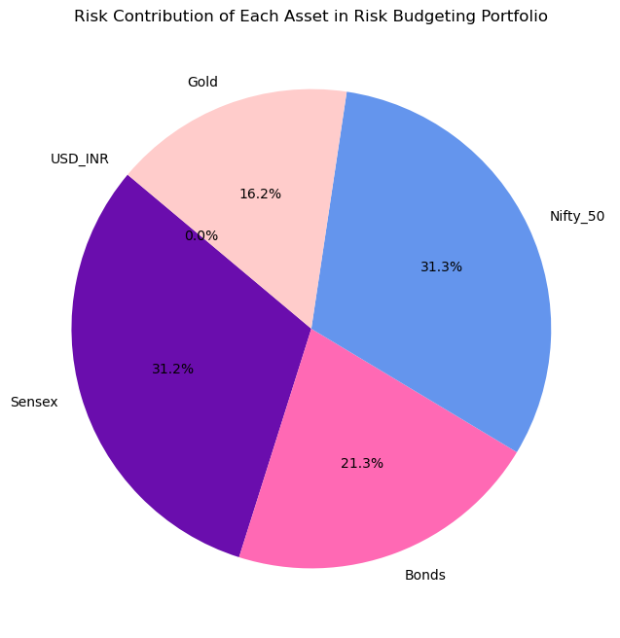
Risk Contributions:
Variables | Sensex | Bonds | Nifty 50 | Gold | USD_INR
Values | 0.31239135 | 0.21257473 | 0.31254491 | 0.16248901 | 0.0
These are the percentages each asset contributes to the portfolio’s overall risk. For example, Sensex and Nifty 50 each contribute approximately 31% of the total risk, Bonds contribute around 21%, and Gold contributes about 16%.
The total portfolio risk is exactly 1.

Slide 17

3. Principal Component Risk Budgeting Portfolio
The objective of PCRBP is to make a portfolio in which the value of risk is diversified across uncorrelated components rather than each asset individually, using the structure of RPP or RBP.
Optimal Weight:
Variables | Sensex | Bonds | Nifty 50 | Gold | USD_INR
Values | 0.19370513 | 0.19421129 | 0.19377883 | 0.14461104 | 0.27369371
The weights are balanced (e.g., 0.1937, 0.1942, etc.) but reflect small adjustments to manage risk according to each principal component's contribution.
This distribution reflects the PCRBP’s goal of allocating risk according to principal components rather than individual assets.

Slide 18
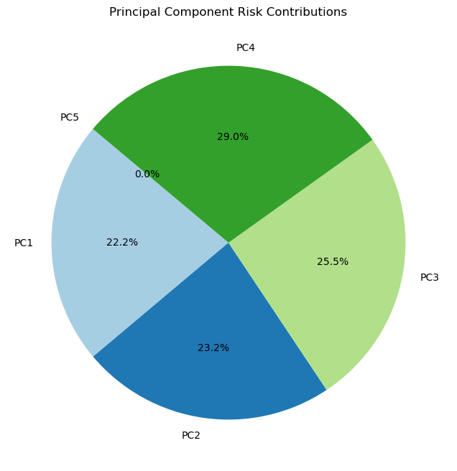
Risk Contributions:
Variables | Sensex | Bonds | Nifty 50 | Gold | USD_INR
Values | 8.22e-03 | 8.58e-03 | 9.43e-03 | 1.07e-02 | 3.35e-09
This distribution reflects the PCRBP’s goal of allocating risk according to principal components rather than individual assets.
The small values confirm that risk is spread across components, but with emphasis on the first few, as expected in PCRBP.
The total portfolio risk of 0.1923 is the combined risk after balancing risk across principal components.

Slide 19
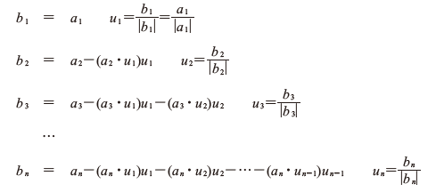
4. Gram-Schmidt Orthonormalization Process
Gram Schmidt Orthonormalization is used to transform asset returns into uncorrelated risk source, that we can understand as unique fluctuation of each asset, which helps the investor to know how different asset independently contribute to portfolio risk.
Centralization of Returns (ai): Centralize the asset returns to ensure that the covariance of the transformed returns has zero value of mean.
Applying the Gram-Schmidt process to derive uncorrelated vectors

Slide 20

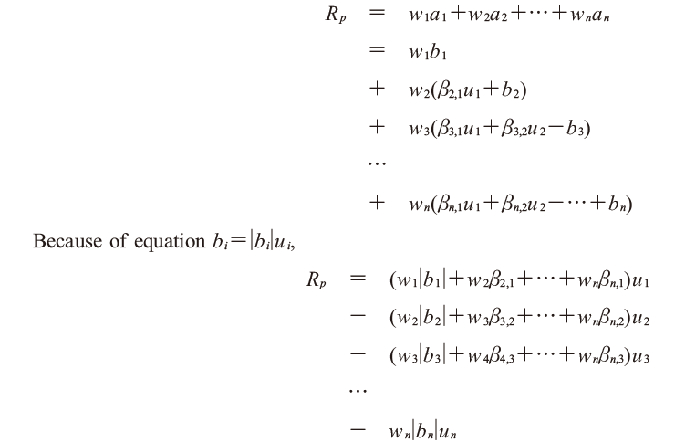
ai⋅uj=βi,j (for j=1,…,n−1), which leads to the following transformed returns:
The portfolio return Rp is represented as:

Slide 21
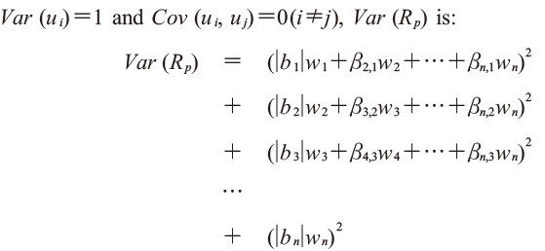
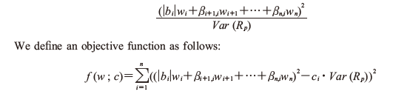
Variance of Portfolio Rp Using the properties Var(ui)=1 and Cov(ui,uj)=0 (for i≠ji), the variance of Rp becomes:
The proportion of an orthonormalized assets variance to the total variance of the portfolio is:

Slide 22
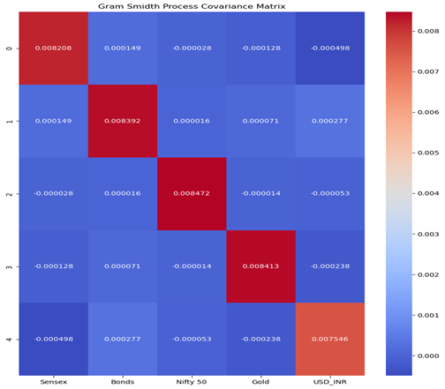
Gram-Schmidt Orthonormalization Portfolio (GSOP)
After orthogonalizing we get each asset to be independent of each other i.e., risk of one assets does not overlap risk of other asset
Covariance Matrix After Orthogonalization

Slide 23
Total Portfolio Risk
The total portfolio risk of 0.0401 represents the overall level of risk or variability in the portfolio’s returns.
A lower number would mean the portfolio's returns are more stable and less volatile. A higher number would indicate greater risk, meaning the returns could vary more widely from day to day.
Total portfolio risk of 0.0401 suggests that, on average, the portfolio’s returns won’t fluctuate very much.

Slide 24
Gram-Schmidt Orthonormalization Portfolio Weight:
Variables | Sensex | Bonds | Nifty 50 | Gold | USD_INR
Values | 0.2 | 0.2 | 0.2 | 0.2 | 0. 2
An equal weight allocation suggests that each asset has the same proportion in the portfolio. In a fully diversified GSOP portfolio, weights are typically not exactly equal unless the covariance matrix and target risk contributions align in a way that leads to such a distribution.
Equal weights might indicate that either:
The assets’ individual risks (variances) were very similar.
The Gram-Schmidt orthonormalization process and optimization constraints pushed toward an equal-weight solution.

Slide 25
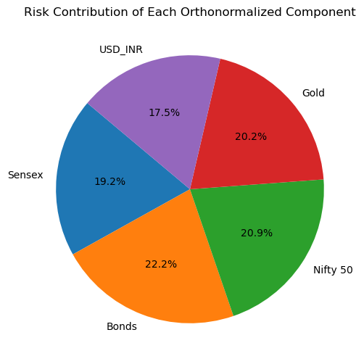
Risk Contributions:
Variables | Sensex | Bonds | Nifty 50 | Gold | USD_INR
Values | 0.192 | 0.222 | 0.209 | 0.202 | 0. 175
Applying the Gram-Schmidt orthogonalization, the portfolio shows balanced risk contributions across all assets.
This balance creates a diversified portfolio where each asset independently contributes to risk without overlap, enhancing stability and flexibility for risk management.

Slide 26
Order of orthogonalization
In Gram-Schmidt orthogonalization, the asset order affects the portfolio by determining how unique risk contributions are calculated. This helps Risk Parity/Budgeting strategies balance risk across uncorrelated components.
Why Order Matters in Orthogonalization ?
1. Risk Distribution
2. Portfolio Performance

Slide 27
Criteria for Optimal Orthogonalization Order
1. Correlation
2. Volatility
Steps in Optimal Ordering :
Define the Objective
Generate Permutations
Evaluate Each Permutation
Choose the Best Permutation
Re-optimization

Slide 28
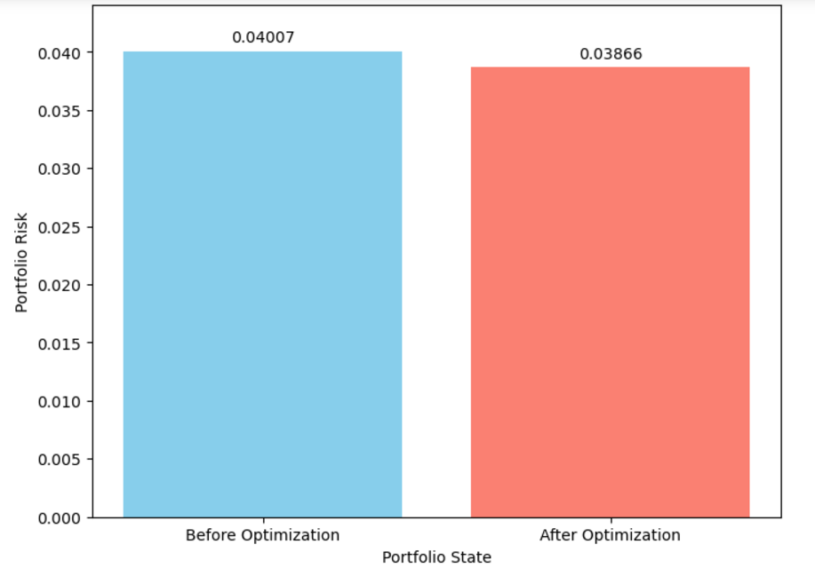
Fig: Comparison of Portfolio Risk before and after optimizing the order

Slide 29
Result and Conclusion
Risk Reduction: Achieved portfolio risk of 0.0401, showing lower return variability compared to other methods.
Balanced Risk Contributions: GSOP provides balanced asset risk contributions Bonds(22.2%) ,Nifty(20.9%) ,Gold (20.2%) ,Sensex(19.2%), Currency(17.5%)
Identified the Ideal Order: The ideal permutations include order such as Sensex, Bonds, Gold, Nifty50, Currency. GSOP performed better than the other portfolios, such as RPP and RBP in terms of lower risk

Slide 30
Limitation and Future Scope
Dependency on Historical Data: The methods used depends heavily on historical data for estimating asset returns , volatilities and correlations.
Assumption of Stationarity: Assumed during the analysis the historical volatility and correlation patterns are relatively stable
Investor Behaviour is Not Considered.
Broader Asset Inclusion: Expand GSOP to include alternative assets (e.g., real estate, cryptocurrencies) and international markets to explore deeper diversification benefits.
Develop adaptive risk budgets and automated rebalancing strategies that adjust based on market conditions for improved stability.

Slide 31
References
Meucci, A. (2009). Managing diversification. Risk, May 2009.
Meucci, A., Santangelo, A., & Deguest, R. (2015). Risk budgeting and diversification based on optimized uncorrelated factors. SSRN. https://doi.org/10.2139/ssrn.2276632
Kamauchi, K., & Yokouchi, D. (2021). A method for risk parity/budgeting portfolio based on Gram-Schmidt orthogonalization. Hitotsubashi Journal of Commerce and Management, 54(1), 15–27. https://doi.org/10.15057/hjcm.2020002
Roncalli, T. (2013). Introduction to risk parity and budgeting. Chapman and Hall/CRC Financial Mathematics Series.
Markowitz, H. (1952). Portfolio Selection. Journal of Finance 7(1), 77-91

Slide 32
Thank you

